Slide 1
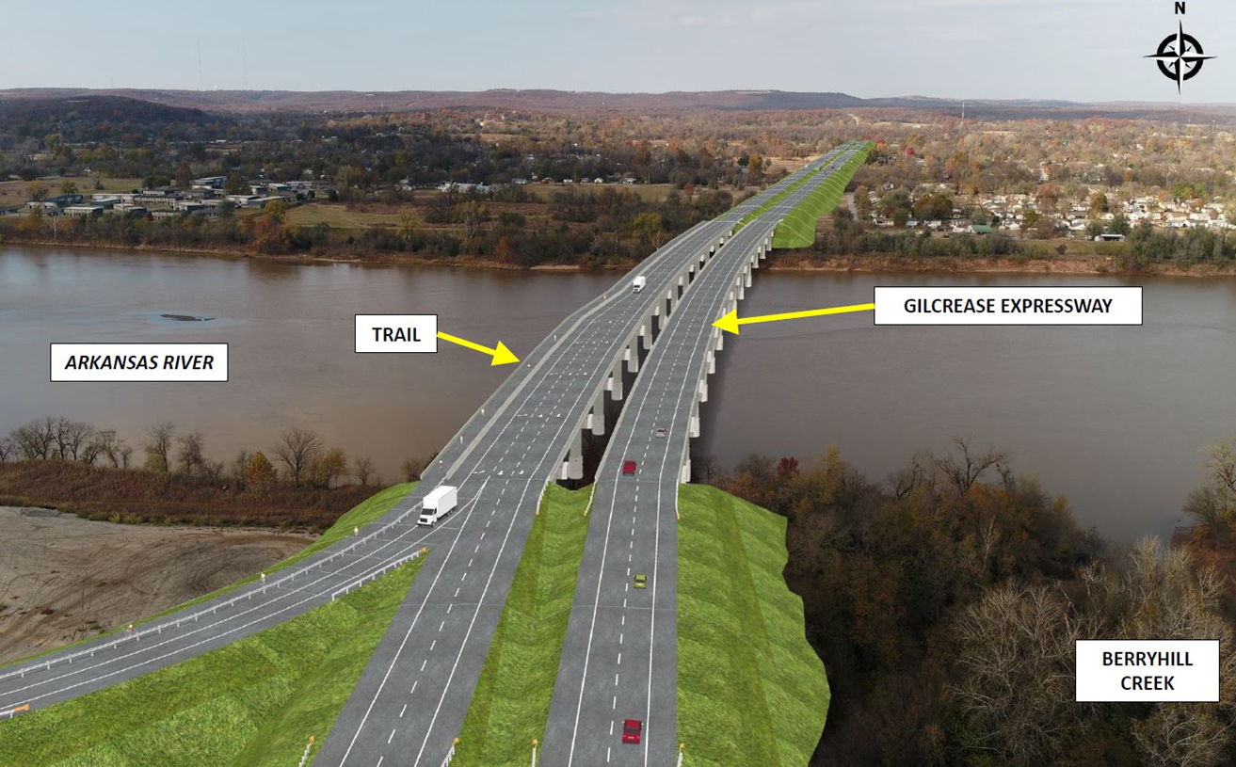


Gilcrease Expressway West
Pre-SOQ Submittal Meeting
June 28, 2018

Slide 2
Presenters
OKLAHOMA TURNPIKE AUTHORITY
Tim Gatz
Executive Director
Joe Echelle, PE MBA
Assistant Executive Director
Maintenance, Engineering and Construction
Wendy Smith
Director of Finance and Revenue

Slide 3
Agenda
Overview of the Oklahoma Turnpike Authority
Project Description
Overview of Request for Qualifications
Contact Information
Questions

Slide 4
Disclaimers
This meeting is being held for information purposes only
Interested parties and Respondents may not rely on any verbal communications relating to the Request For Qualifications (RFQ) or the Gilcrease Expressway West Project (Project)
The RFQ and any addenda posted on the Procurement Website, as well as any written responses provided by the Authority to questions regarding the RFQ submitted in accordance with the requirements of the RFQ, are the only documents on which Respondents should rely in submittal of a Statement of Qualifications (SOQ)

Slide 5
Introduction to the Authority
    The Oklahoma Turnpike Authority (Authority) is an instrumentality of the State of Oklahoma, originally created by the state legislature by statute in 1947 for the purpose of constructing, operating and maintaining the Turner Turnpike
    In 1953, the Authority was granted authority to construct additional turnpikes and its membership was revised to include a representative from each of Oklahoma’s congressional districts
    The state legislature has the exclusive right to authorize turnpike routes
    The Authority is responsible for completing necessary engineering and economic feasibility analyses of any authorized routes prior to any construction
    The Authority has the right to determine whether to construct a turnpike route that the legislature has authorized, and the right to set toll rates on all turnpikes it constructs

Slide 6
Map of Current Oklahoma Turnpikes

Slide 7
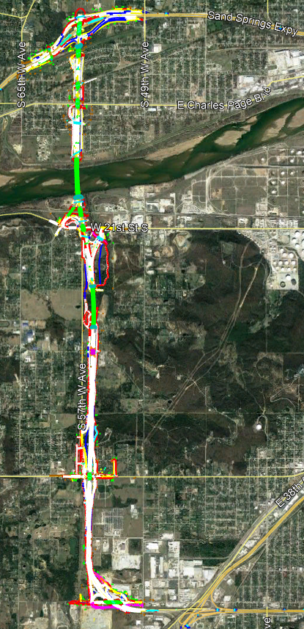
Gilcrease Expressway West Project Description
Project will complete a segment of the planned Tulsa expressway network between I-44 and US-412
Project will consist of a fully functional four lane divided tolled highway connecting I-44 to US-412
Total length approximately 5 miles of concrete pavement
22 bridges including two bridges (one for each direction of traffic) over the Arkansas River
Four interchanges at W 51st St, W 41st St, W 21st St, and US-412
3rd party will install and test electronic tolling system
Highway lighting and cable barrier safety median
Parallel 10ft wide concrete trail from W 51st St to Katy Trail just south of US-412

Slide 8


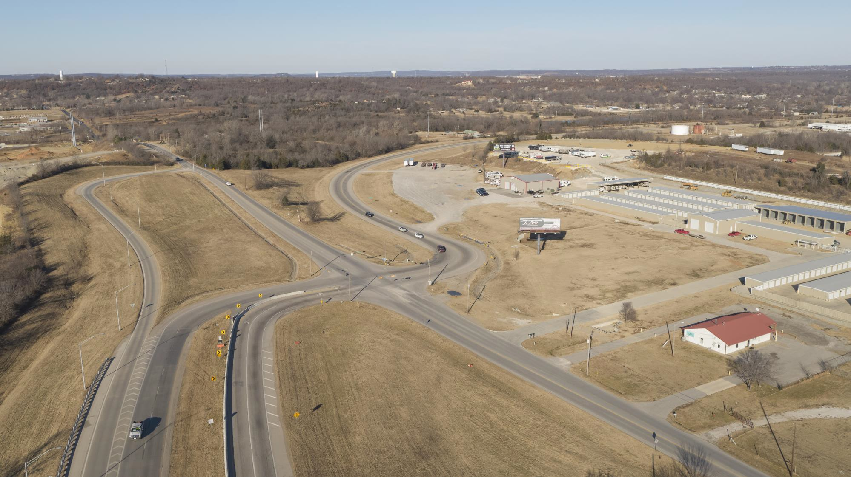

W. 51st Street
GILCREASE EXPRESSWAY

Slide 9
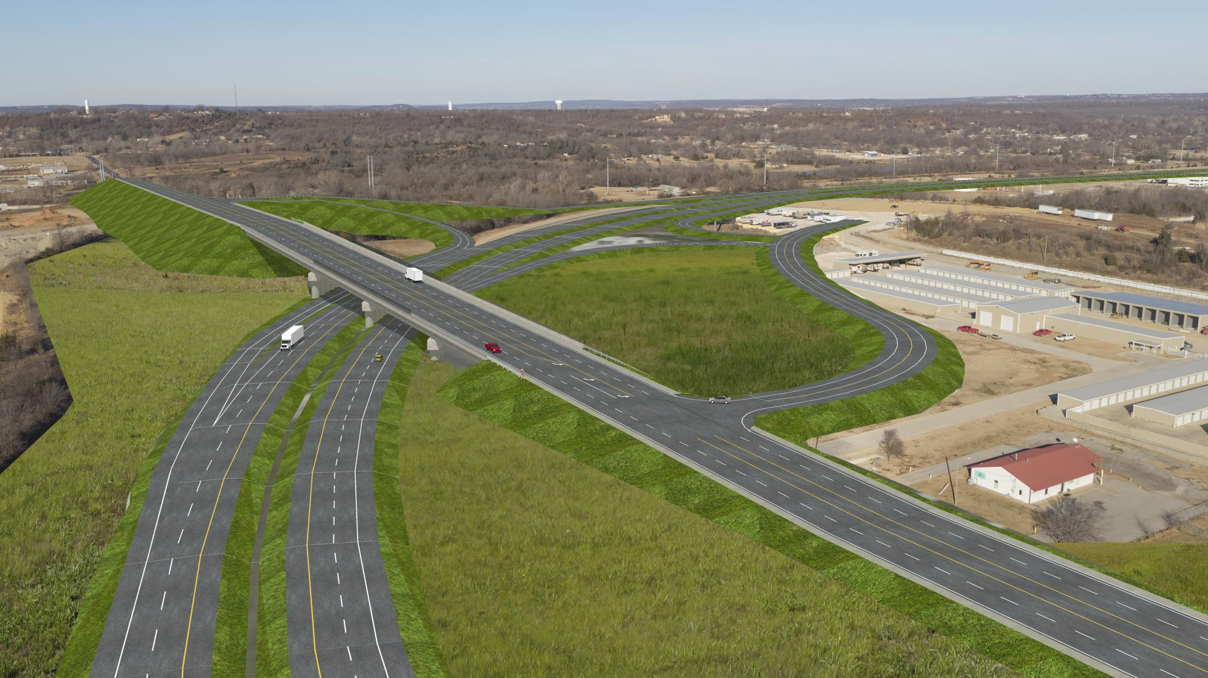

W. 51st Street
GILCREASE EXPRESSWAY

Slide 10


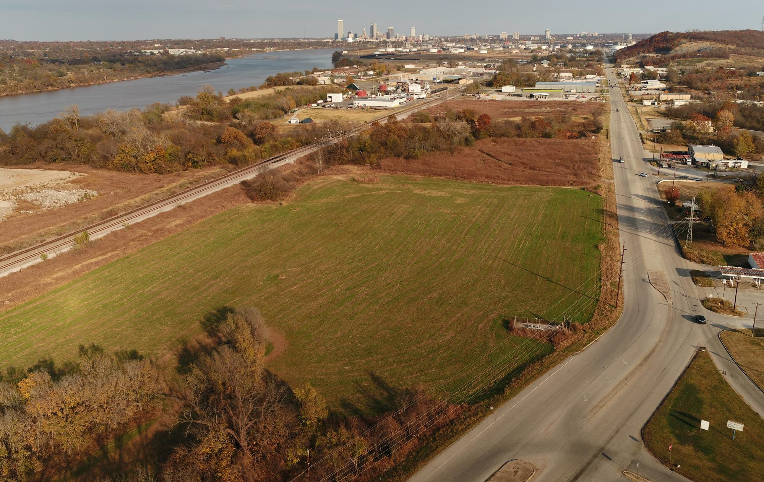



W. 21st Street
57TH W. AVE.

Slide 11

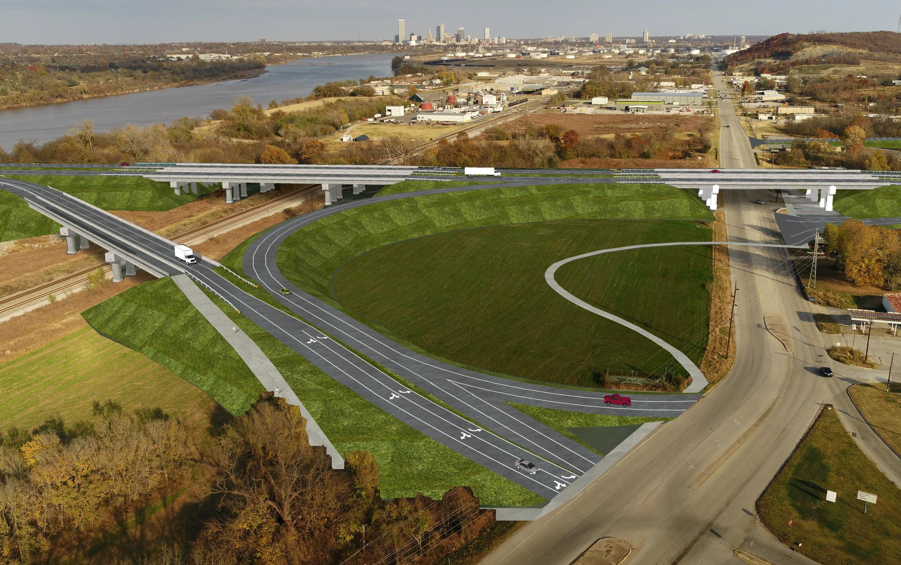


W. 21st Street
GILCREASE EXPRESSWAY
57TH W. AVE.
TRAIL

Slide 12
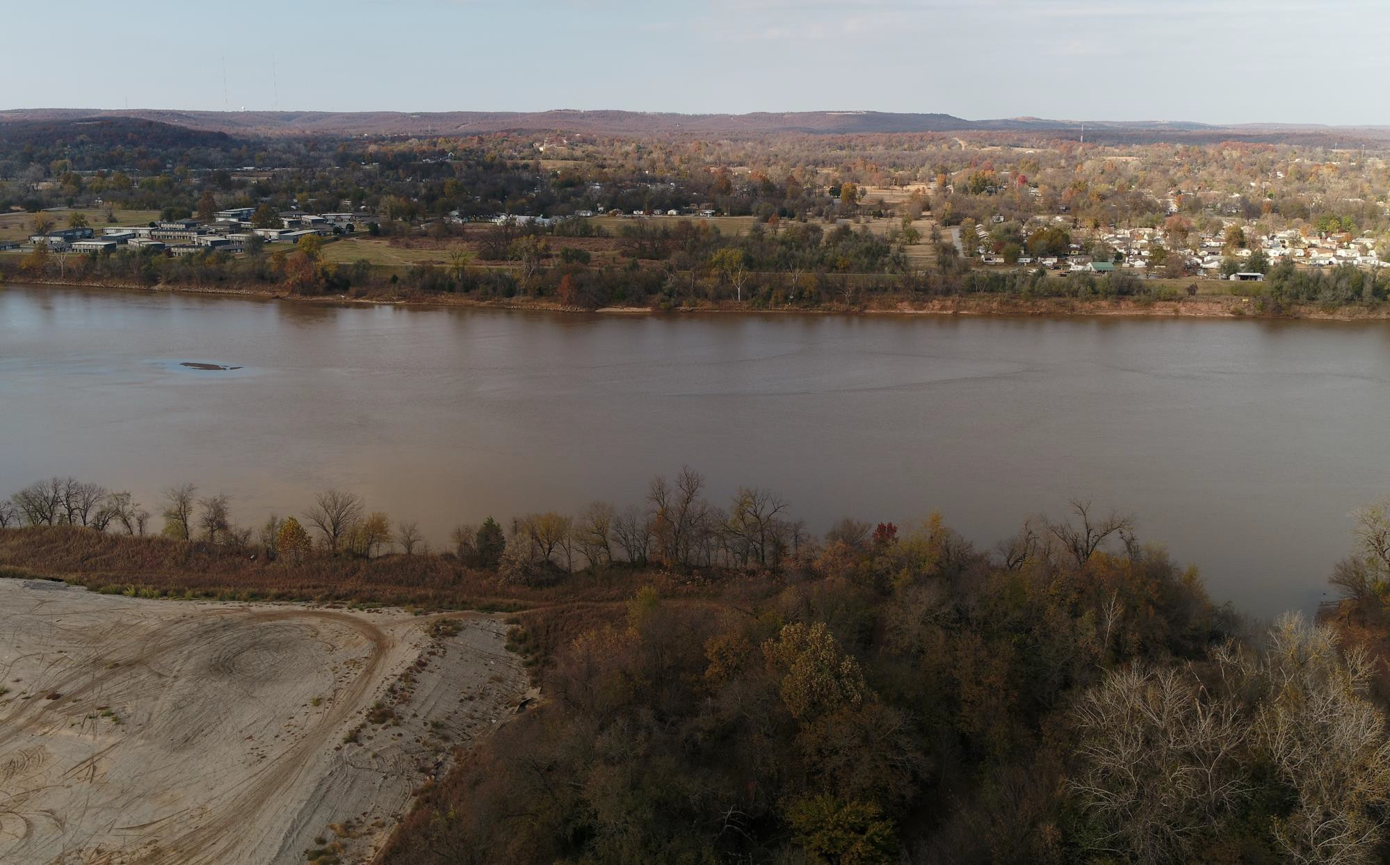

Arkansas River
ARKANSAS RIVER
BERRYHILL CREEK

Slide 13
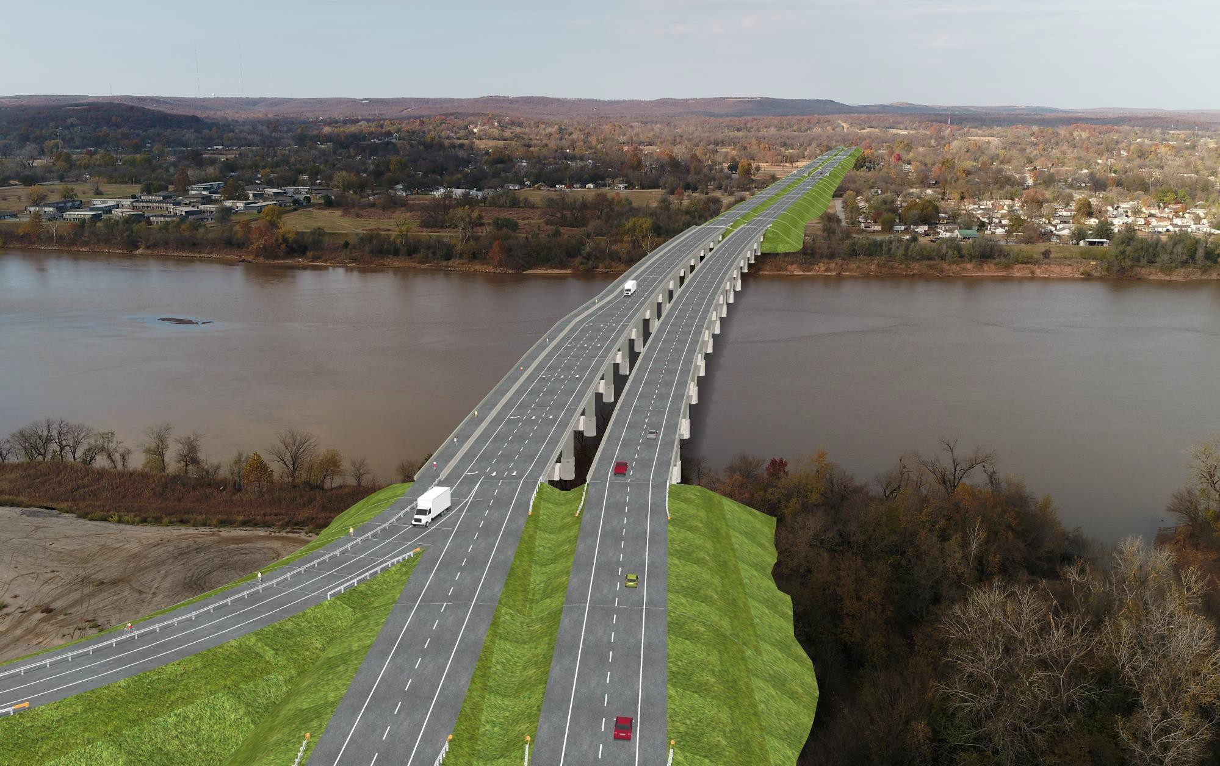
Arkansas River
GILCREASE EXPRESSWAY
TRAIL
ARKANSAS RIVER
BERRYHILL CREEK

Slide 14

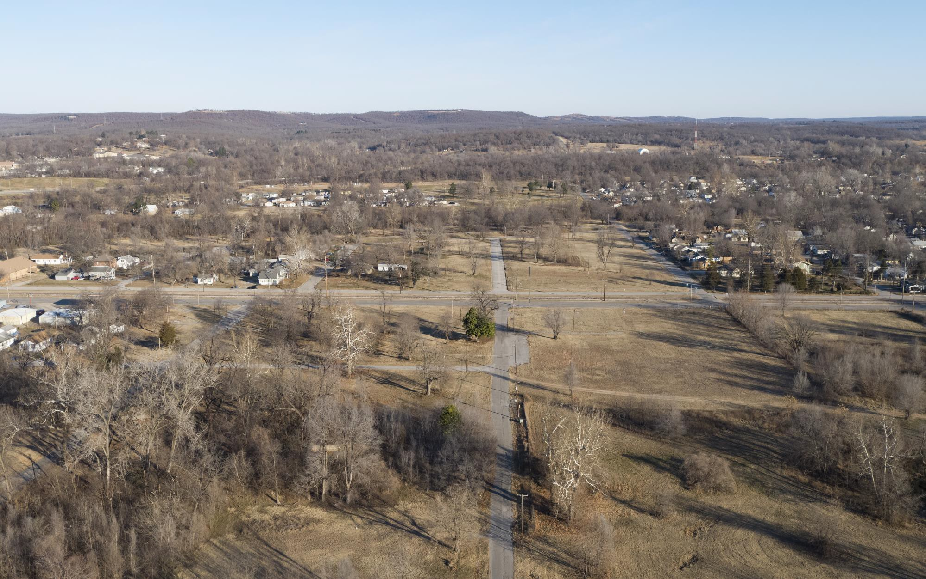

Charles Page Blvd.
CHARLES PAGE BLVD.

Slide 15

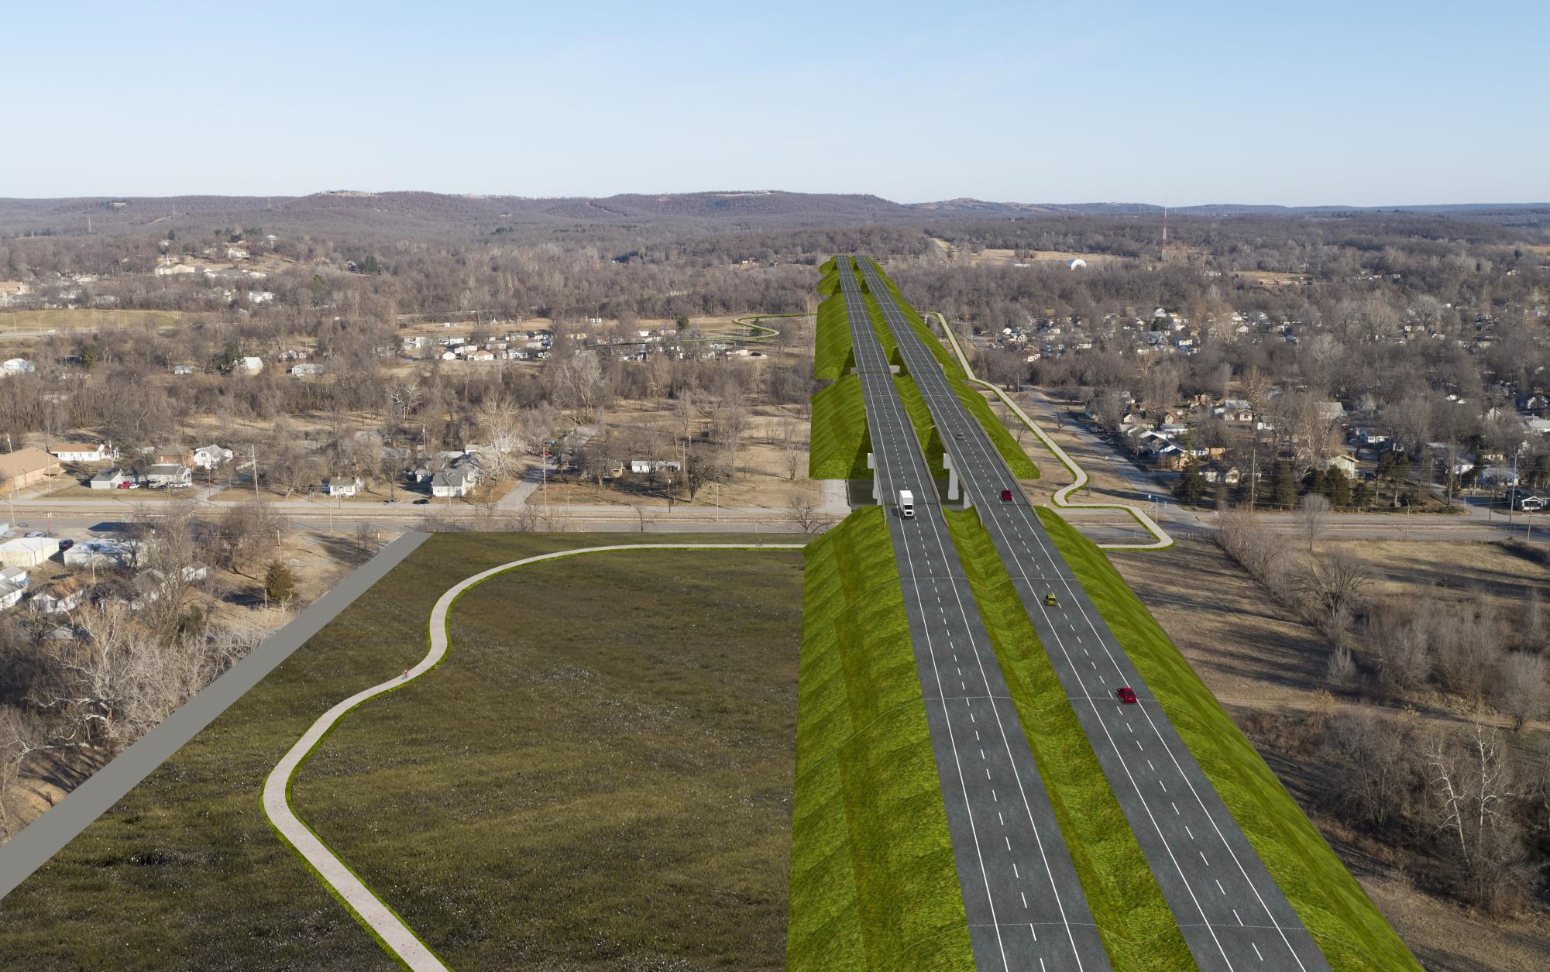

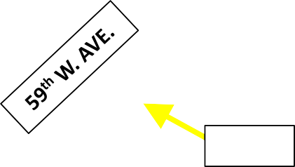
Charles Page Blvd.
CHARLES PAGE BLVD.
TRAIL
TRAIL

Slide 16
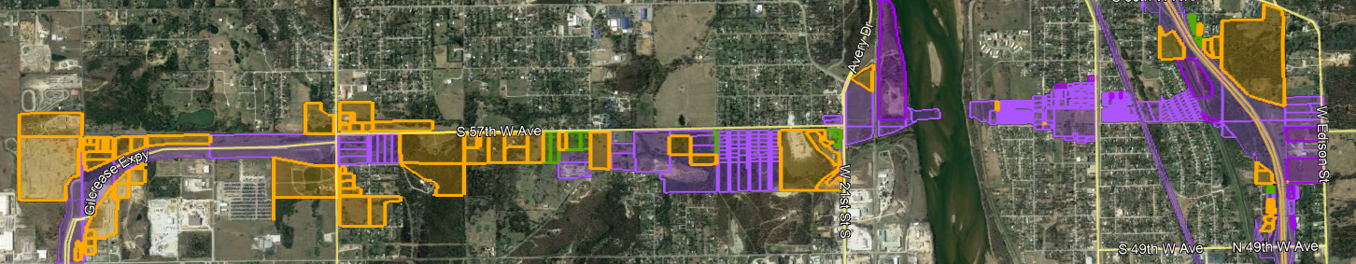
Right-of-Way and Utilities
Right-of-Way Acquisition:
  In 2000, FHWA authorized the City of Tulsa to begin acquisition of ROW
    The Authority and City of Tulsa have continued to acquire ROW
    An additional 77 parcels need to be acquired (shown in orange)
  Right of way acquisition expected to be complete by November 2018
Utilities:
  OTA to undertake necessary utility relocation activities
  Expected to be complete by end of 2018
  Project Company will be responsible for relocation of certain City of Tulsa water and sewer utilities

Slide 17
Environmental Status
An Environmental Assessment (EA) was prepared and approved by FHWA in 2000.
Reevaluations of the EA were completed in 2005 and 2014 to update information and request right-of-way acquisition authorization.
The Authority will complete an additional reevaluation of the EA to authorize construction
  Updated environmental studies and additional public involvement
  Re-evaluation expected to be completed by Q3 2018
The Authority held a well-attended Public Meeting in February 2018 to discuss the Project
USACE Section 404 Permitting process is in progress targeting 2018 end of year completion

Slide 18
Federal Requirements
The Project is subject to FHWA’s Buy America Policies
Equal Employment Opportunity requirements will be contained in the Request for Proposals (RFP)
The Project is subject to prevailing wage and employee protection requirements (Davis-Bacon) contained in 23 U.S.C. §113
The RFP will contain a Disadvantaged Business Enterprise Participation goal

Slide 19
Build-Finance Structure*
The Authority is seeking a Project Company in connection with the construction and financing of the Project
In general, the Project Company will be responsible for:
  Financing a portion of the capital costs of the Project on an interim basis
  Clearance and demolition of the Project Site
  Relocation of certain City of Tulsa owned water and sewer lines
  Construction of the Project in compliance with the Technical Requirements, the Authority’s construction standards and all environmental, health and workplace safety requirements
  Oversight and management of all work including the work and prompt payment of subcontractors
  Completion of all required commissioning and acceptance testing
  Provision of pedestrian and bicycle trail components
  Other site work and services required including drainage improvements
  Traffic management
  Public communications, together with the Authority
  Coordination with other projects in or near the Project Site
  Completion and warranty work as will be specified in the RFP
* Preliminary, subject to the Technical and Financial Requirements to be included in the RFP

Slide 20
Project Budget and Funding
The Project is anticipated to be funded from a combination of the following:
  Interim construction financing to be provided by the Project Company
  Public funds
    Proceeds of GARVEEs issued by ODOT on May 30, 2018
    Authority funds
    TIFIA loan proceeds
    Cash contributions already received from other public stakeholders
Subject to requirements to be set forth in the RFP and the Project Agreement, the Project Company will receive payments from the public funds noted above
The Authority expects to provide Proposers the flexibility to develop a financing structure that is the most beneficial to and cost-effective for the Authority
Any payment obligation of the Authority under the Project Agreement will be limited to Authority moneys specifically made available by the Authority for the Project
The Project Company will not have any rights against, or be considered a 3rd party beneficiary of, the TIFIA loan or any of the other 3rd party public funds described above

Slide 21
Procurement Objectives
Conformance to applicable law and regulations
Safety of the public, the Project, and employees and users
Optimization of Project schedule
Optimal and efficient financing of the Project
Economic development to the State
Minimization of construction, operational, maintenance, repair and replacement costs
Maximization of value provided to the Authority
High quality construction resulting in a high quality and efficiently functioning Project
High degree of build-finance coordination
Appropriate risk transfer
Prudent management and protection of public resources
Being a good neighbor to adjacent properties and other projects in the vicinity
Coordinated development between the Authority and the Project Company

Slide 22
Procurement Process
Issue Request for Qualifications
Evaluate Statements of Qualifications and potential Interviews
Short-list qualified Respondents
Issue draft RFP (including draft Project Agreement) to Short-listed Respondents
Individual meetings with Short-listed Respondents
Consideration of Alternative Technical Concepts by Authority
Issue RFP to Short-listed Respondents
Submittal of Proposals by Short-listed Respondents
Proposal Evaluations
Selection of Project Company
Finalization of Project Agreement
Financial and commercial close

Slide 23
Respondent Teams
Respondent Team Members
Respondent Team Lead
Project Company
Equity Provider(s), if applicable
Construction Lead
Finance Lead
Guarantor(s), if applicable
Each Key Individual
Any other Person identified by the Respondent in its SOQ
Key Individuals
Project Manager
Finance Manager
Construction Manager
Quality Control Manager
Any other Person identified by the Respondent in its SOQ
A Person may serve in multiple roles on the Respondent Team, e.g. Construction Lead may also serve as the Respondent Team Lead, an Equity Provider or in all 3 capacities
The Respondent Team Lead, Construction Lead and any Equity Provider (as well as affiliates) shall NOT be allowed to participate in these roles on another Respondent Team

Slide 24
Submittal Requirements and SOQ Evaluations
Submittal Requirements (RFQ Section 6)
  Package 1: Transmittal Letter / Respondent Team & Financial Capacity
  Package 2: Technical Qualifications
  Package 3: Project Finance Qualifications
  Package 4: Supplemental Information Submittal (Optional)
SOQ Evaluation and Ranking (RFQ Section 7)
  Threshold Responsiveness
    Substantial completeness of SOQ Submittal
    Adequate Financial Capacity
  SOQs not meeting Threshold Responsiveness may result in the SOQ not being evaluated
SOQ Evaluation Criteria
    70% Technical Qualifications
    30% Financial Qualifications
SOQ Submittal Deadline August 8, 2018
4:00 pm Oklahoma time

Slide 25
Alternative Technical Concepts
The RFP is expected to provide an opportunity to Short-listed Respondents to make and propose Alternative Technical Concepts (ATCs)
The RFQ provides a suggested process for incorporating ATCs into the procurement
Respondents are encouraged to provide comments on the proposed process

Slide 26
Schedule (all specified times are prevailing Oklahoma City Time)
Date | Activity
June 22, 2018 | Issue RFQ
June 28, 2018 | Pre-SOQ Submittal Information Meeting
July 13, 2018 4:00 PM | Deadline for Submittal of Comments or Questions on RFQ
July 20, 2018 | Last Date for Authority Posting of Responses to Comments and Questions
Aug 8, 2018 4:00 PM | SOQ Submittal Deadline
Aug – Sept 2018 | Announcement of Short-listed Respondents
Sept 2018 | Issue draft RFP with Initial Draft Project Agreement to Short-listed Respondents
Oct – Nov 2018 | Individual Meetings with Proposers and Consideration of Alternative Technical Concepts
December 2018 | Issue Final RFP with final Draft Project Agreement
First Quarter 2019 | Proposals Due
First Quarter 2019 | Approval of Preferred Proposer by Board
September 2021 | Estimated date of Substantial Completion

Slide 27
Communications
Written questions regarding the RFQ must be made in writing via email to the Contact Person prior to July 13, 2018 at 4:00 pm Oklahoma Time (Section 5.7 of RFQ)
Restricted Communications Period begins with the issuance of the RFQ (6/22/18) and ends upon finalization and notification of the Short-listed Respondents
Restricted Communications Period for Short-listed Respondents continues until execution of the Project Agreement
No interested party, Respondent or Proposers, including any of their representatives, may contact any Prohibited Contact Person during the Restricted Communications Period
Prohibited Contact Persons
Key Stakeholders
The Authority
Oklahoma Department of Transportation
City of Tulsa, Oklahoma
Tulsa County, Oklahoma
Indian Nations Council of Governments
FHWA
Consultant Support Team
CDM Smith Inc
EGL Law, PLLC
Garver
Hawkins Delafield & Wood LLP
Hilltop Securities Inc
Kutak Rock LLP
Olsson Associates
Poe & Associates
Public Finance Law Group PLLC
Others as may be added

Slide 28
Procurement Website and Contact Information
Background materials are located on the Procurement Website at:
http://www.drivingforwardok.com/gilcrease-expressway
Materials are provided to assist Respondents and the Authority makes no representation as to the relevance, accuracy or completeness of any information except as otherwise expressly provided in the RFQ
Respondents must check the Procurement Website periodically for addenda and it is the responsibility of each Respondent to ensure its SOQ incorporates all information and requirements of the RFQ including any addenda
The Contact Person is the Authority’s point of contact for all communications concerning the RFQ
Contact Person:
        Jordan Perdue
        (405) 425-2782
        jperdue@pikepass.com

Slide 29
QUESTIONS
PLEASE NOTE ONLY WRITTEN RESPONSES TO QUESTIONS SUBMITTED IN ACCORDANCE WITH THE REQUIREMENTS OF THE RFQ MAY BE RELIED ON IN SUBMITTAL OF AN SOQ

